Slide 1
CH2PH1:
Chemical Kinetics
Dr. James Hallett j.e.hallett@reading.ac.uk

Slide 2
Workshop 1

Slide 3
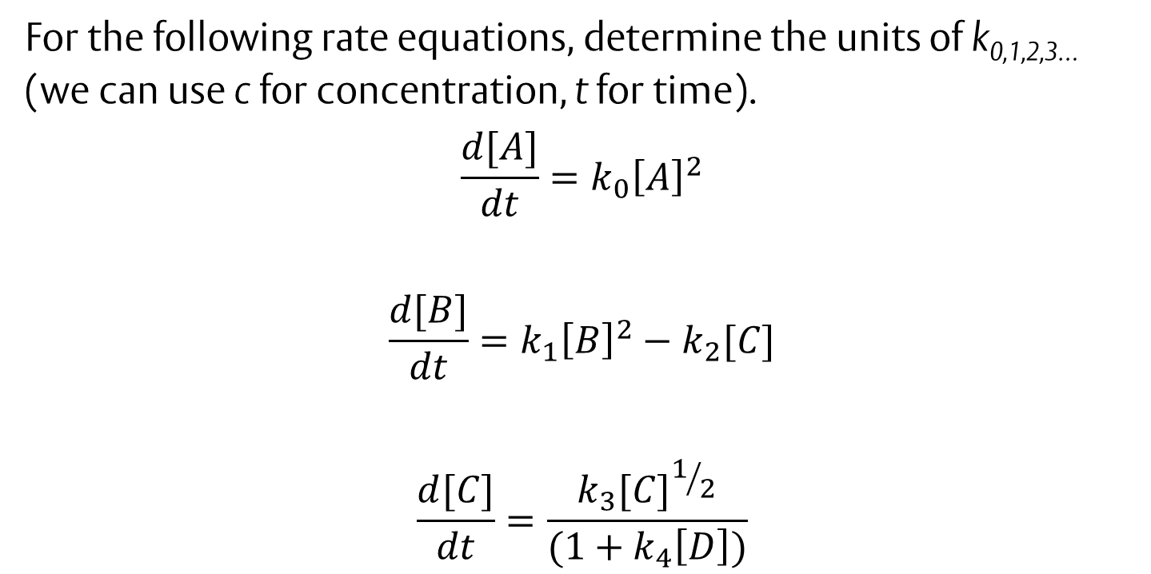
Question 1
For the following rate equations, determine the units of k_{0,1,2,3…} (we can use c for concentration, t for time).
$$\frac{d[A]}{dt}=k_{0}{\left[A\right]}^{2}$$
$$\frac{d[B]}{dt}=k_{1}{\left[B\right]}^{2}−k_{2}[C]$$
$$\frac{d[C]}{dt}=\frac{k_{3}{[C]}^{1/2}}{(1+k_{4}\left[D\right])}$$

Slide 4
Question 2a
For the elementary reaction A→B with rate constant k:
What is the rate equation?
What are the units of k?
What is the rate of consumption of A?

Slide 5
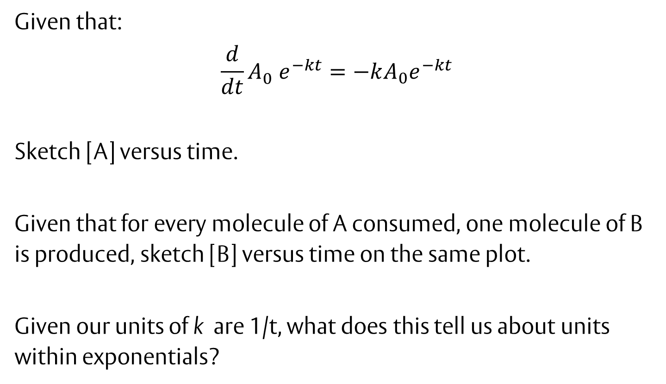
Question 2b
Given that:
$$\frac{d}{dt}{A_{0}^{}e}^{−kt}=−kA_{0}e^{−kt}$$
Sketch [A] versus time.
Given that for every molecule of A consumed, one molecule of B is produced, sketch [B] versus time on the same plot.
Given our units of k are 1/t, what does this tell us about units within exponentials?

Slide 6
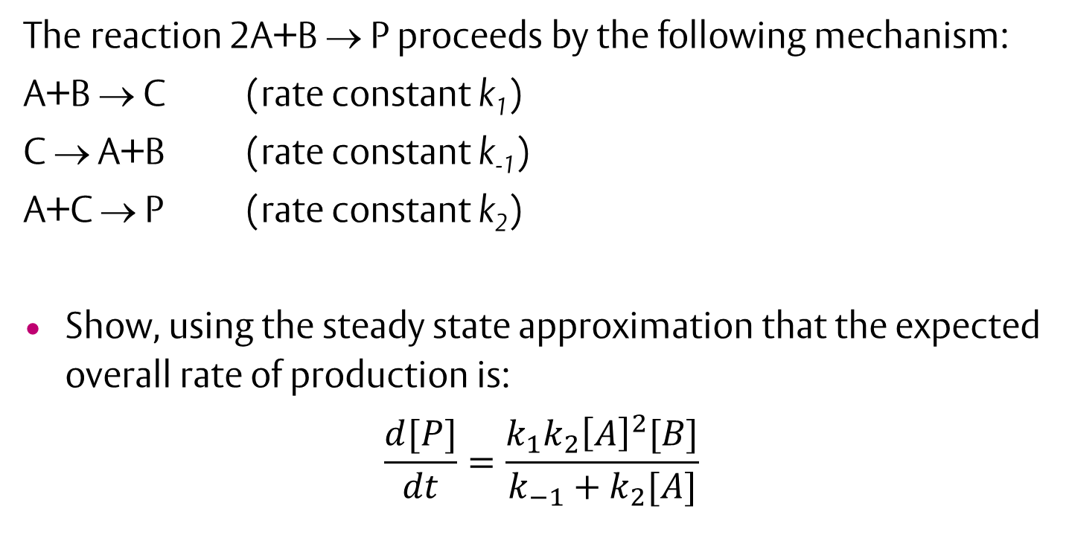
Question 3
The reaction 2A+B → P proceeds by the following mechanism:
A+B → C (rate constant k₁)
C → A+B (rate constant k₋₁)
A+C → P (rate constant k₂)
Show, using the steady state approximation that the expected overall rate of production is:
$$\frac{d[P]}{dt}=\frac{k_{1}k_{2}{\left[A\right]}^{2}[B]}{k_{−1}+k_{2}[A]}$$

Slide 7
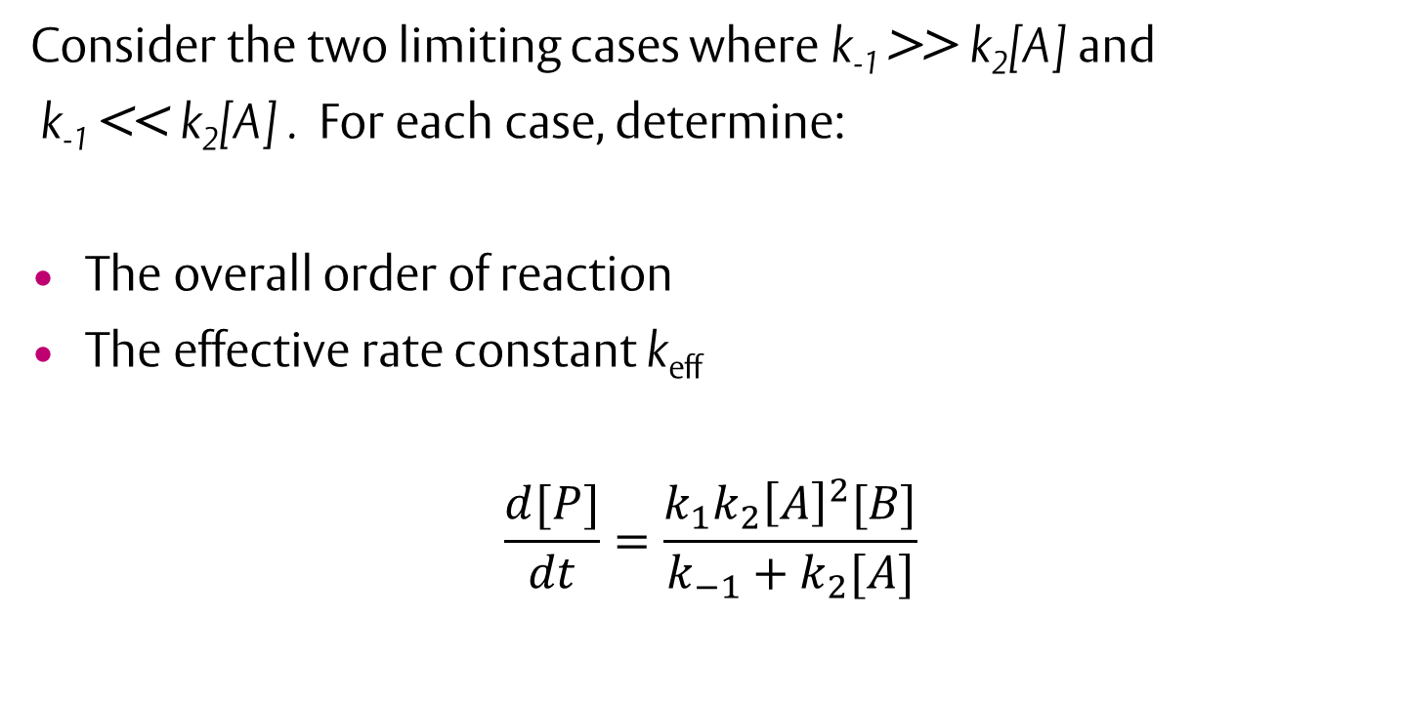
Question 4
Consider the two limiting cases where k₋₁ >> k₂[A] and
k₋₁ << k₂[A] . For each case, determine:
The overall order of reaction
The effective rate constant k_{eff}
$$\frac{d[P]}{dt}=\frac{k_{1}k_{2}{\left[A\right]}^{2}[B]}{k_{−1}+k_{2}[A]}$$

